Slide 1
Frank Slide at Turtle Mountain Alberta Canada
Luke Kevan, Tyler Remund, Kevin South
Group 5

Slide 2
History
https://www.youtube.com/watch?v=P9NnkcvAklA

Slide 3
History
Notes:
Town is located at the base of Turtle Mountain, below and unstable limestone deposit. The mining town was largely destroyed by the slide which caused an estimated 80 deaths. The town was established in 1901 as the result of the discovery of coal.

Slide 4
History
Notes:
This is the town the day after the slide. 90 million tons of debris slid down the mountain and buried much of the town. The local coal mine was also buried but was later reopened after being cleared of debris. The portion of the slide that covered the town was left where it was and the resident who were buried beneath it were never dug up.

Slide 5
History
Notes:
Today the slide remains almost exactly as it did in 1903. The town stopped growing once the mine shut down in 1917 but It is a popular tourist destination today.

Slide 6
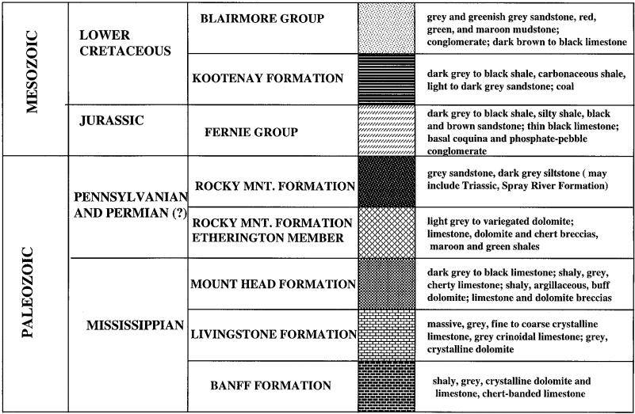
Stratigraphy of Turtle Mountain
Notes:
The rocks involved in the Frank slide consisted predominantly of Paleozoic limestone.

Slide 7
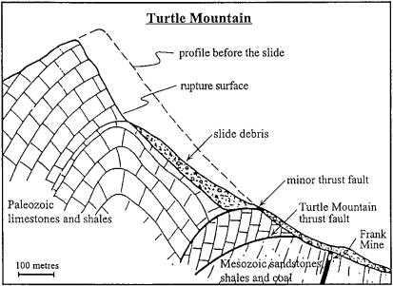
Failure Mechanism
Notes:
Complex failure mechanism: fracturing of intact rock, shear and separation along discontinuities. The geological structure definitely played a role; jointed limestone. Triggering mechanism suggestions: ice wedging, earthquake tremors, water pressures, underground coal mining at the base of the mountain.

Slide 8
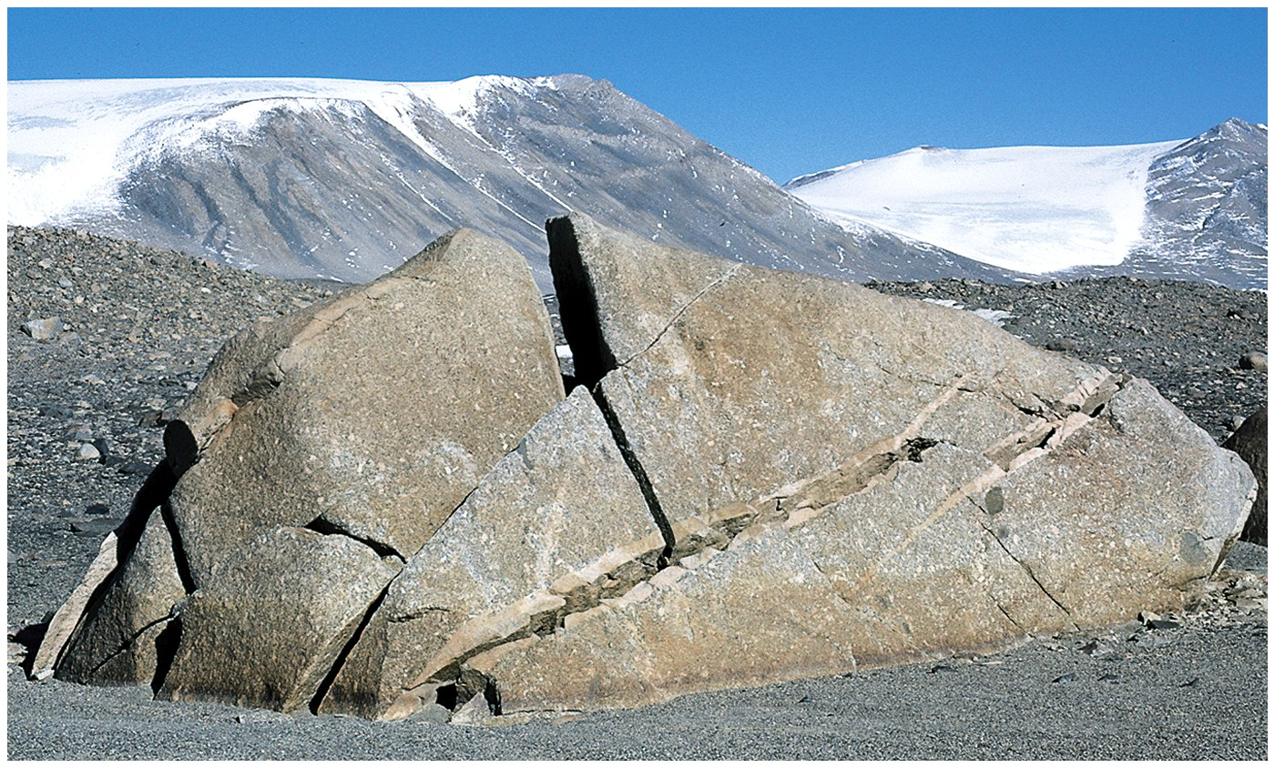
Ice Wedging

Slide 9
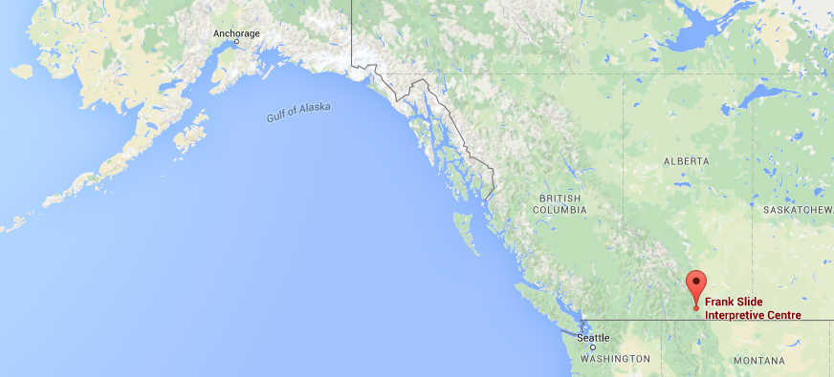
Seismic Loading
1901 Aleutian Islands Magnitude 7.8 Earthquake

Slide 10
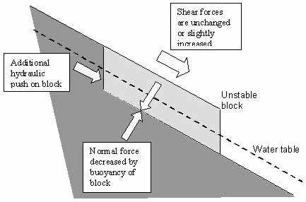
Excessive Rainfall 4 years preceding slide
Notes:
Pore Pressures increase which adds buoyancy to the block reducing resistance, the movement of groundwater can add a hydraulic push to the block, weight of the block itself is increased.

Slide 11
Influence of mining on the stability of Turtle Mountain
It is almost impossible to avoid the conclusion that these great chambers, 130 feet long, 250 to 400 feet high, and 15 feet wide, situated directly under the foot of the mountain must have weakened it. The loose coal, being less resistant than the unmined, would allow slips or readjustments in the hanging wall, and the jar produced by these may have been sufficient to snap some of the few remaining supports, which held the unbalanced mass in place. For in its state of unstable equilibrium, the slightest movement, a movement of even one inch, might have a profound effect upon Turtle Mountain. It is a significant fact that these edges of the break correspond very closely with the limits of the big chambers of mined coal. (McConnell and Brock 1904)
Notes:
Slight movements had been observed by miners several months prior to failure. The coal began to mine itself due to ground squeeze. The gangways and manways had to frequently be retimbered and even condemned. Mining chambers were 76 to 122 m in height. The mine did not suffer any damage and reopened shortly after the slope failure.

Slide 12
Failure Mechanism Conclusions
Adverse anticlinal structure primary cause
Mining could have influenced failure

Slide 13
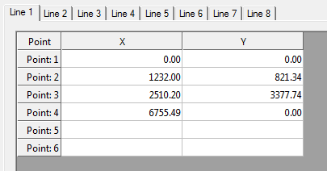
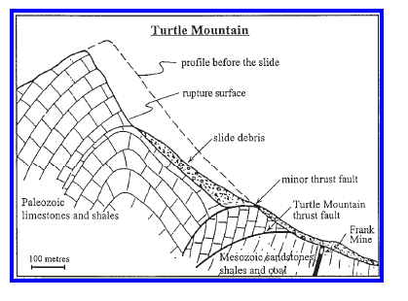
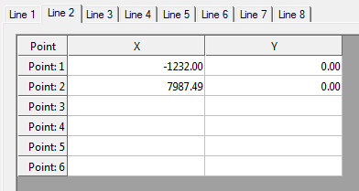
Analysis
Mountain Profile
Profile Lines Derived

Slide 14
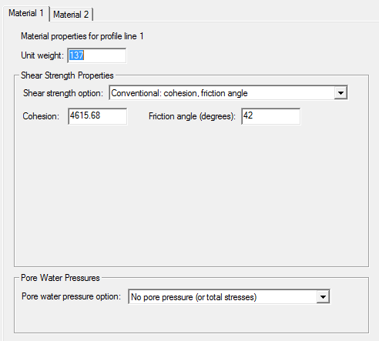
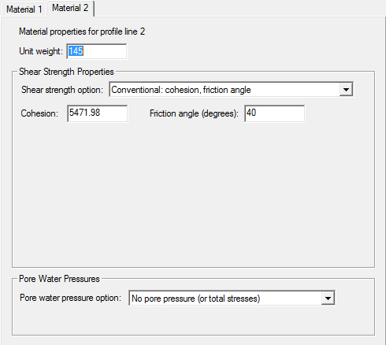
Analysis
Notes:
Material Properties

Slide 15
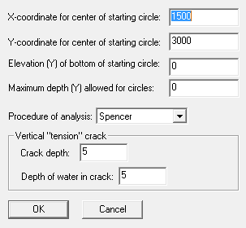
Analysis

Slide 16
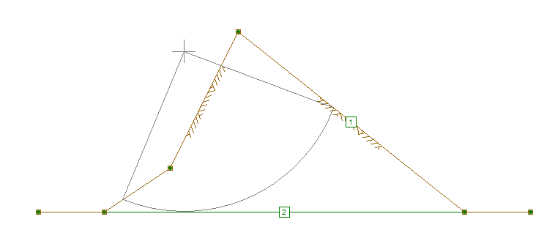
Slope Analysis

Slide 17
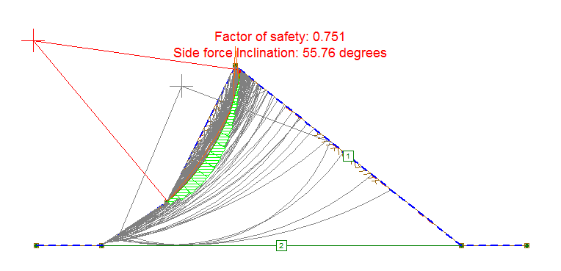
Analysis
Analysis without tension crack

Slide 18
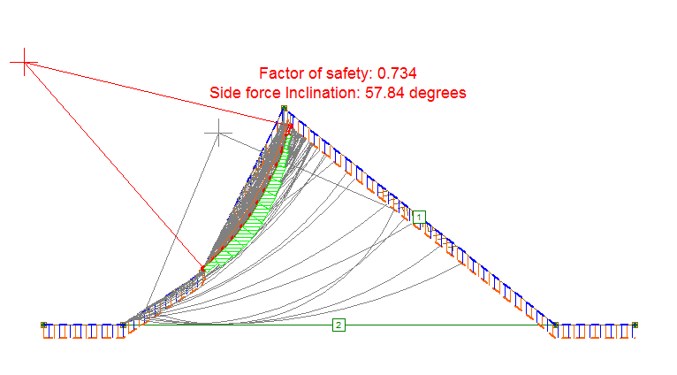
Analysis
Analysis with tension crack

Slide 19
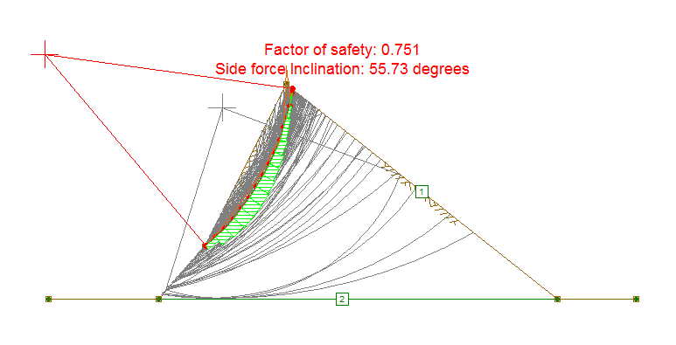
Analysis
Analysis with steeper slope

Slide 20
Conclusion
We agree that the slide was not caused by mining, but by fractures in the rock with higher than normal rains.

